Slide 1
Treasure Island
English 8 & English 8 A.S. BCHS

Slide 2
The Author
Robert Louis Stevenson
Born in Edinburgh, Scotland on November 13, 1850.
He was a sickly boy and was doted on by his parents and confined mostly to a bed.
His parents wanted him to become a lighthouse engineer like the rest of his family
He said “NO WAY!”

Slide 3
The Author
Robert Louis Stevenson
He was 23 when he developed a respiratory illness and was sent to the French Riviera to recuperate.
He met an America woman there, Fanny Osbourne. They fell in love and dated for two years. He moved to California with her in 1878.
Robert was very poor and his parents were NOT HAPPY about them as a couple and refused to pay for anything to help them.

Slide 4
The Author
BUT…..
They got married and finally good ole Pops relented and gave them some “moolah.”
The family went back to Scotland in and Robert spent most of his time writing even though he was really ill.
In 1887 they went to America and found he was FAMOUS! :-o

Slide 5
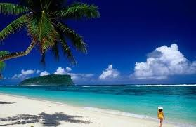
The Author
They chartered a yacht and sailed for the South Seas with his wife, stepson, mom, and stepdaughter. It was so pretty they decided to live there.

Slide 6
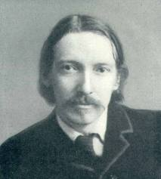
The Author
Robert Louis Stevenson…
Died in 1894 of a brain hemorrhage and not of the long- feared tuberculosis which plagued him for most of his life.

Slide 7
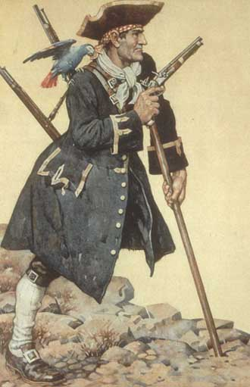
Treasure Island
Stevenson wrote Treasure Island for his teenage stepson, Lloyd.
He wanted him to write something that was actually interesting.
The novel has no secret symbols. Simply a good narrative about a daring young boy, buried treasure, and of course PIRATES!

Slide 8
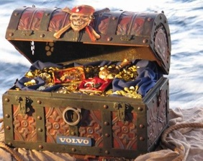
5 Myths About Pirates
Myth 1: All pirates were rich from their adventures.
Many of the pirates died poor, hungry, and without a single piece of buried treasure.
There were strict laws about how to divide treasure. Most pirates didn’t get much of it.

Slide 9
5 Myths About Pirates
Myth 2: All pirates were lawless, robbing with no purpose but their own pleasure.
Many privateers whose purpose was for their own country.
Aboard a ship, the pirates followed a strict code of rules called articles.

Slide 10
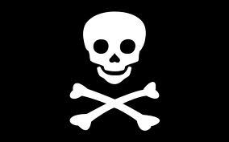
5 Myths About Pirates
Myth 3: All pirates sailed under the Jolly Roger.
Sometimes they did.
Sometimes it was just a black square. Or it was a flag with other pictures like a skull, or a beer mug.

Slide 11
5 Myths About Pirates
Myth 4: All pirate captains were tyrants.
A few like Blackbeard were tyrants AND crazy!
But many were elected by their crew. Just like we elect a president.
However, if a crew didn’t like him they could vote him out just like they voted him in!

Slide 12
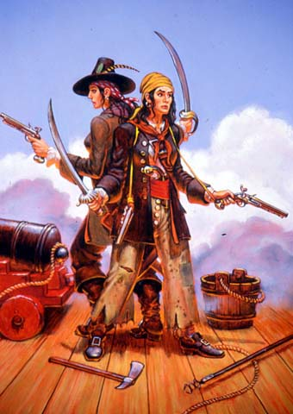
5 Myths About Pirates
Myth 5: All pirates were men.
Some of the BLOODIEST, WICKEDEST, and BEST pirates in the world were women. (Sorry boys!)
Some ships had rules that banned women. BUT Pretty Peg sailed for love, Anne Bonney and Mary Reade sailed for adventure, Jeanne de Belleville sailed for revenge, and Madame Ching led a battalion of 2,000 Chinese!
GIRL POWER!

